Slide 1
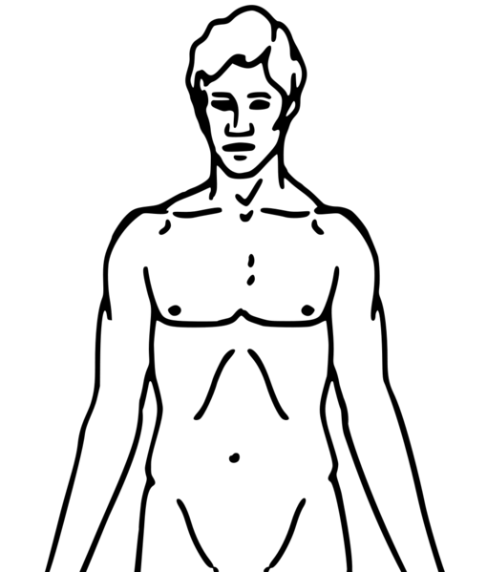
S1: Remove
S3: Apply
S4: Apply
S2: Remove
S1: Apply
S2: Apply
S3: Remove
S4: Remove
Locations
45min
45min
45min
45min
45min
~30min
S1
CREAM 1
TEST
S2
CREAM 2
TEST
S3
A3
A4
CREAM 3
TEST
A1
A2
S4
CREAM 4
TEST
Locations A1 to A4 are randomly assigned to sites S1 to S4.
SLOT01
SLOT02
SLOT03
SLOT04
SLOT05
SLOT06
0:00
0:45
1:30
2:15
3:00
3:45
~4:15
Time buffer for the assessments
PAUSE

